Slide 1
DEVELOPER TRAINING
S1E2 – BASIC HTML5, CSS
NEXT

Slide 2
TIMELINE.
START TIMELINE
HTML5
CSS

Slide 3
SCSS, BEM
Q&As
END TIMELINE

Slide 4
HTML5 & CSS3
HTML5 is a programming language - Hyper Text Markup Language
Add media content like video, audio into webpage
Support drag and drop
Geo location
Notification
Etc…
CSS is a style language that describes how HTML mark-up is presented to the user.
CSS3 is the latest version of the CSS specification.
The HTML5 specification is being developed by two different bodies (the WHATWG and the W3C).

Slide 5
HTML5 ELEMENTS
<!DOCTYPE html> <html lang="en">
</html>
<meta charset="utf-8">
Vs
<meta http-equiv="Content-Type" content="text/html; charset=utf-8">
<script src="js/scripts.js" type="text/javascript"></script>
Vs
<script src="js/scripts.js"></script>

Slide 6
PAGE STRUCTURE
header section with a logo and title
navigation bar body content divided into three columns
articles and ad blocks within the columns
footer containing some author and copyright information

Slide 7
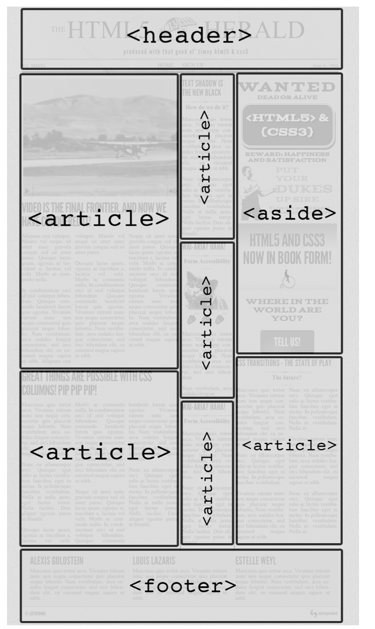
STRUCTURE
<body> <header>
<nav></nav> </header>
<main role="main">
<div class="primary">
<article></article>
</div>
<div class="secondary">
<article></article>
</div>
<div class="tertiary">
<aside><article></article> </aside>
</div> </main><!-- main -->
<footer> <section id="authors">
<section></section> </section>
<section id="copyright"> </section>
</footer>
<script src="js/scripts.js"></script> </body>

Slide 8
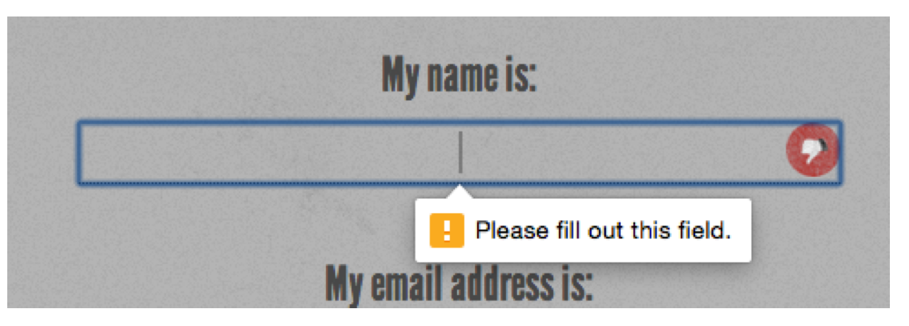
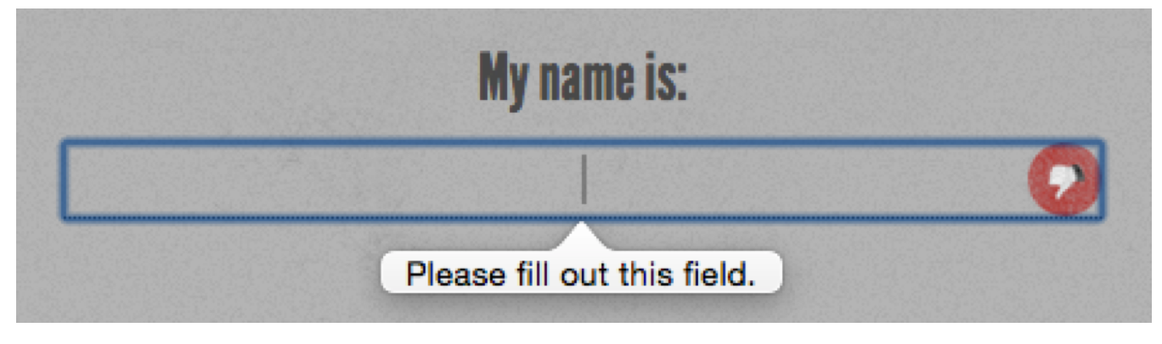
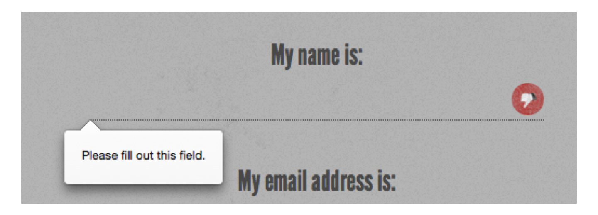
HTML5 FORM
The required Attribute
Placeholder
Regular Expressions
<input type="password" id="password"
name="password"
required title="(at least 6 characters, no spaces)”
pattern="\S{6,}">

Slide 9
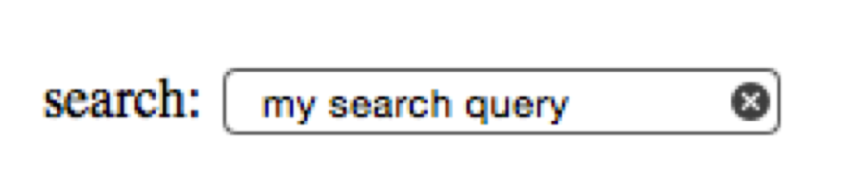
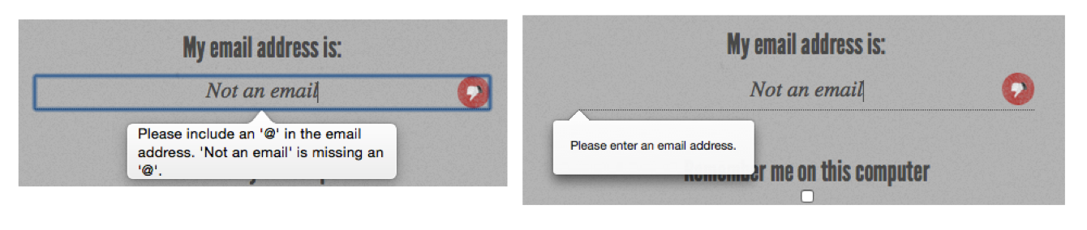
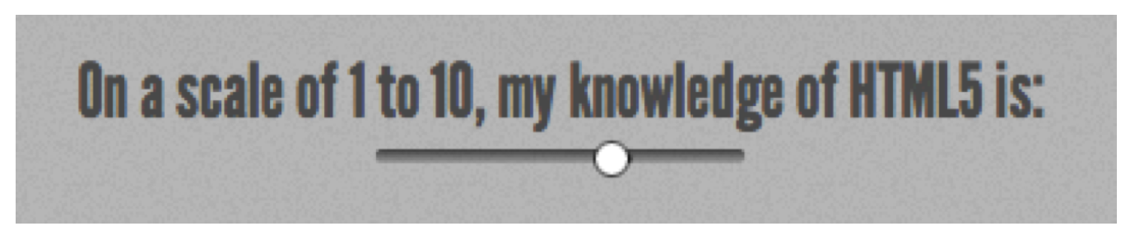
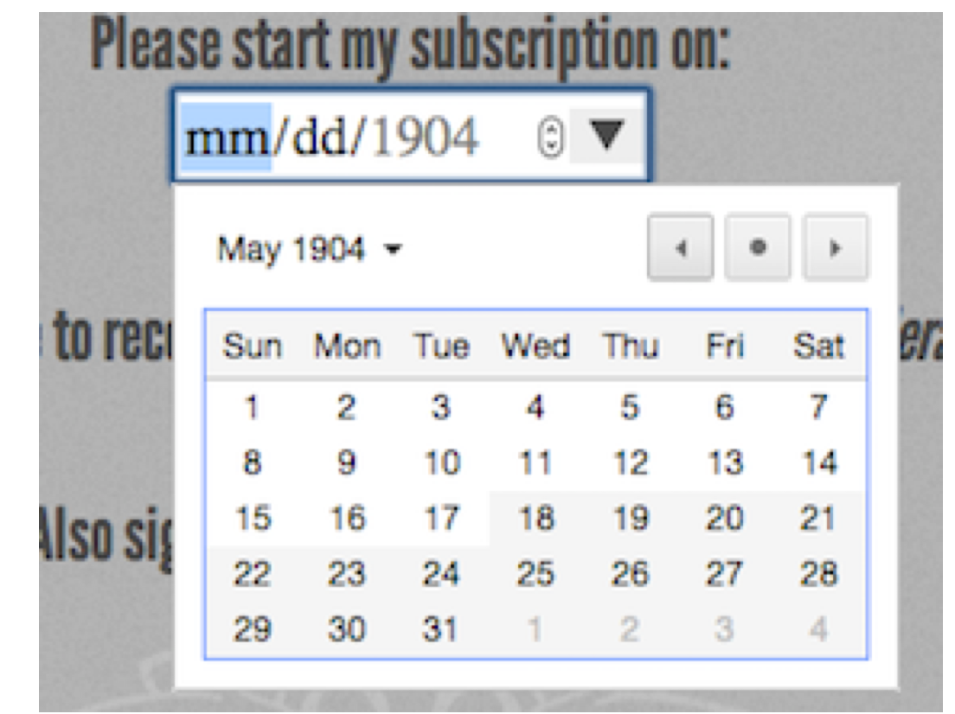
HTML5 FORM - INPUT TYPES
search
email
url
tel
date
time
number
range
color

Slide 10
HTML5 FORM – MEDIA
<video playsinline="" muted="" onplaying="this.controls=false" autoplay loop class="fullscreen-bg__video"> <source src="<?php echo $video_path . $video_name . '.mp4'; ?>" type='video/mp4;'> <source src="<?php echo $video_path . $video_name . '.sd.webm'; ?>" type='video/webm;'> <source src="<?php echo $video_path . $video_name . '.ogv'; ?>" type='video/ogg;'> <!-- Responsive poster images --> <poster-source media="(min-width:1200px)" srcset="<?php echo $video_path . $video_name . '.jpg'; ?>" /> <poster-source media="(min-width:800px)" srcset="<?php echo $video_path . $video_name . '.jpg'; ?>" /> <poster-source srcset="<?php echo $video_path . $video_name . '.jpg'; ?>" /> </video>

Slide 11
CSS3 - Relational Selectors
Descendant combinator (E F)
Child combinator (E > F)
Adjacent sibling, or next sibling selector (E + F)
li + li will target all li elements except the first li in a given container.
General sibling or following sibling selector (E ~ F)
So, h1 ~ h2 will match any h2 that follows an h1, as long as they both share the same direct parent—that is, as long as the h2 is not nested in any other element.

Slide 12
CSS3 - Attribute Selectors
E[attr] => input[required]
E[attr=val] => input[type=check- box]
E[attr|=val] => p[lang|="en"]
=> either has the value en-us or begins with en-uk
E[attr^=val] => E whose attribute attr starts with the value val.
E[attr$=val] => E whose attribute attr ends in val

Slide 13
FLEX BOX
The Flexbox Layout (Flexible Box) module (a W3C Candidate Recommendation as of October 2017) aims at providing a more efficient way to lay out, align and distribute space among items in a container, even when their size is unknown and/or dynamic (thus the word "flex").
Note: Flexbox layout is most appropriate to the components of an application, and small-scale layouts, while the Grid layout is intended for larger scale layouts.

Slide 14
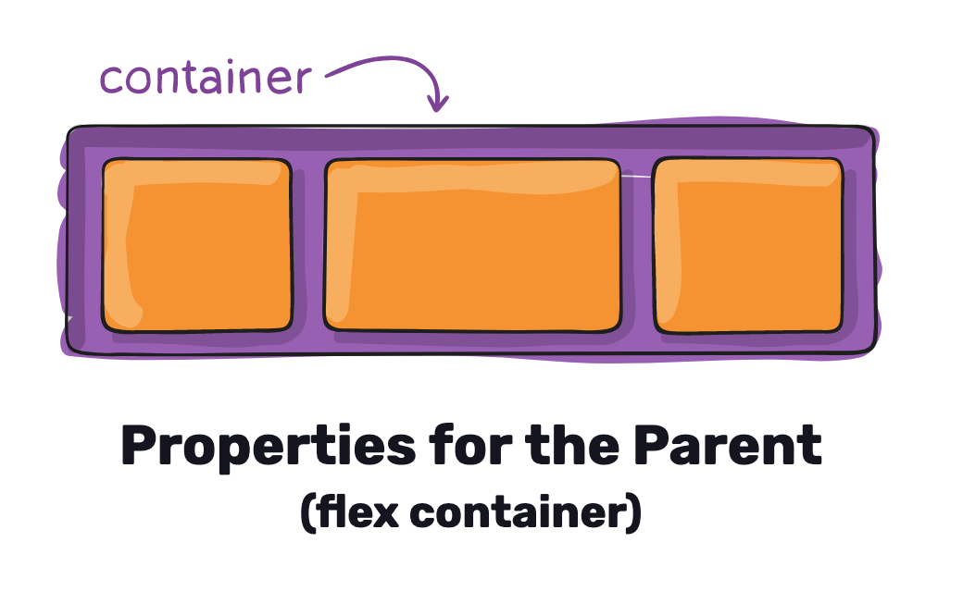
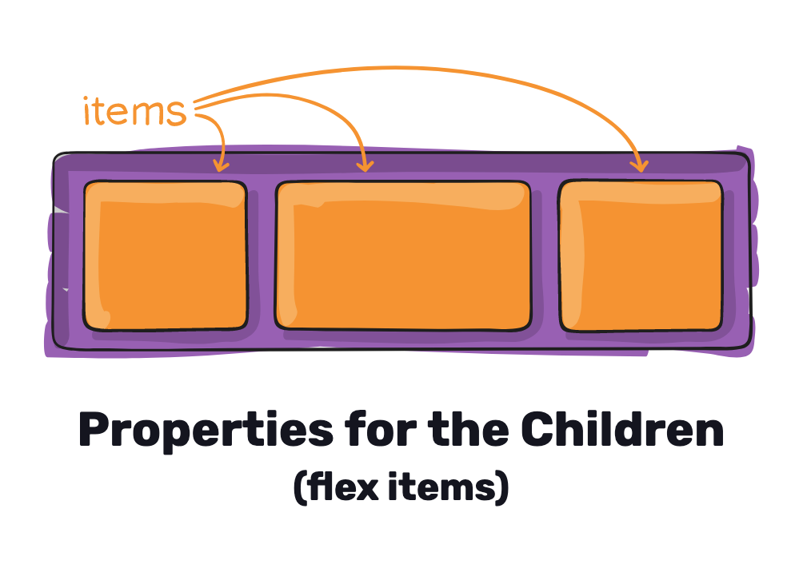
FLEX BOX
.container {
display: flex; /* or inline-flex */
}
display
This defines a flex container; inline or block depending on the given value.
It enables a flex context for all its direct children.

Slide 15
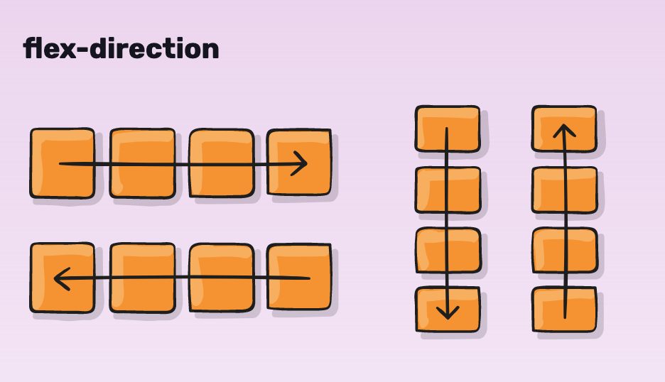
FLEX BOX – FLEX DIRECTION
flex-direction: row | row-reverse | column | column-reverse;
row (default): left to right in ltr; right to left in rtl
row-reverse: right to left in ltr; left to right in rtl
column: same as row but top to bottom
column-reverse: same as row-reverse but bottom to top

Slide 16
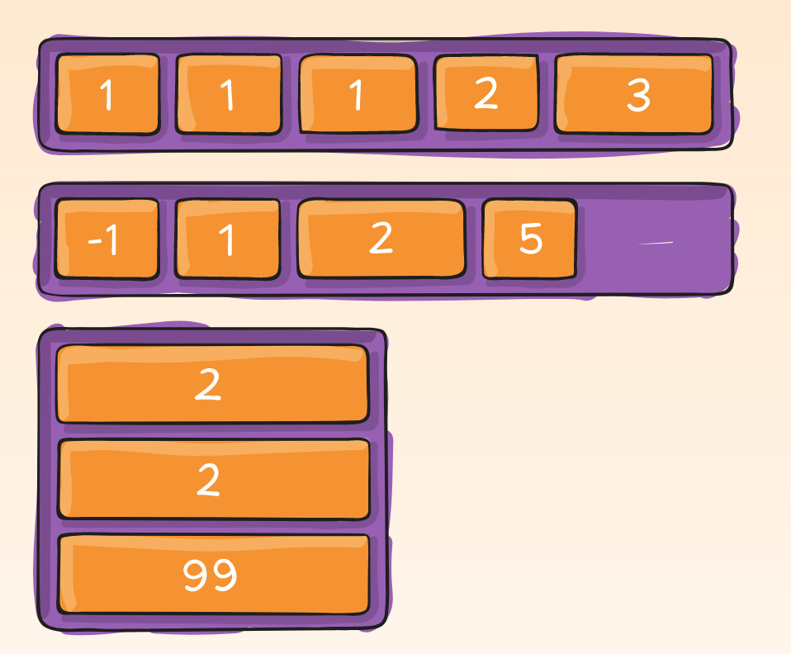
FLEX BOX – ORDER
order: <integer>; /* default is 0 */
By default, flex items are laid out in the
source order. However, the order property controls the order in which they appear in the flex container.

Slide 17
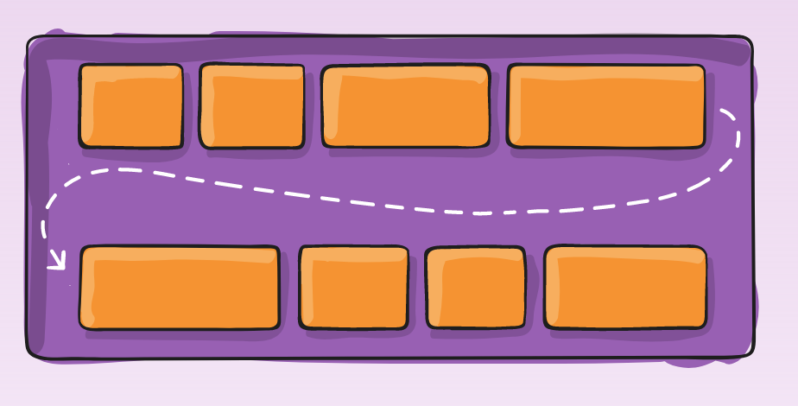
FLEX BOX – WRAP
.container{
flex-wrap: nowrap | wrap | wrap-reverse;
}
nowrap (default): all flex items will be on one line
wrap: flex items will wrap onto multiple lines, from top to bottom.
wrap-reverse: flex items will wrap onto multiple lines from bottom to top.
https://css-tricks.com/almanac/properties/f/flex-wrap/

Slide 18
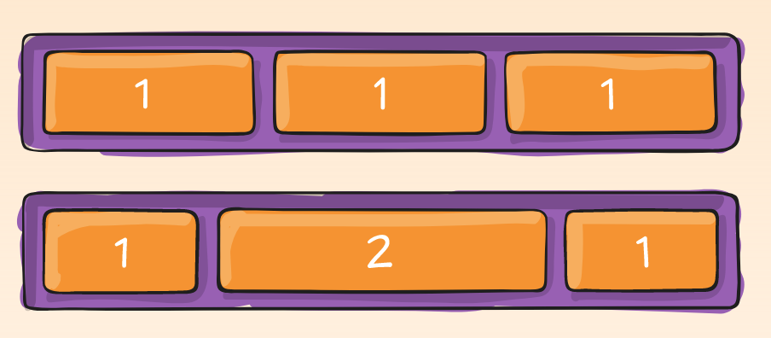
FLEX BOX – GROW
flex-grow: <number>; /* default 0 */
If all items have flex-grow set to 1, the remaining space in the container will be distributed equally to all children. If one of the children has a value of 2, the remaining space would take up twice as much space as the others (or it will try to, at least).

Slide 19
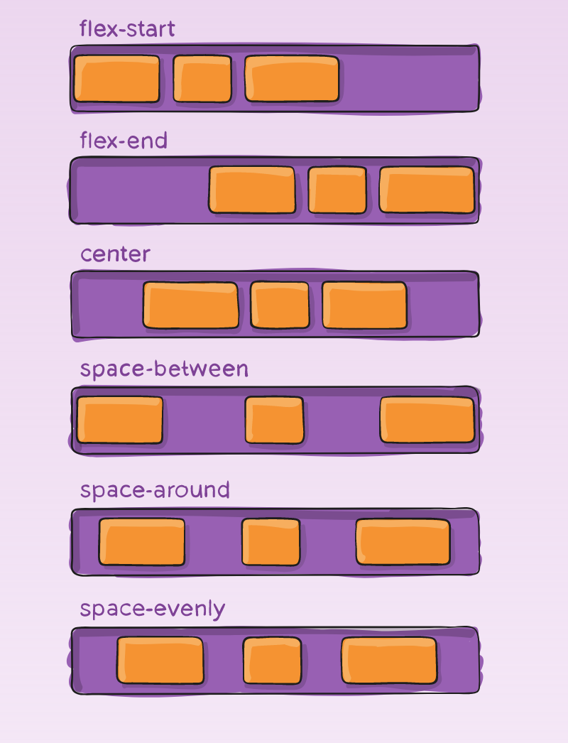
FLEX BOX – justify-content
justify-content: flex-start | flex-end | center | space-between | space-around | space-evenly;
This defines the alignment along the main axis. It helps distribute extra free space left over when either all the flex items on a line are inflexible, or are flexible but have reached their maximum size. It also exerts some control over the alignment of items when they overflow the line.

Slide 20
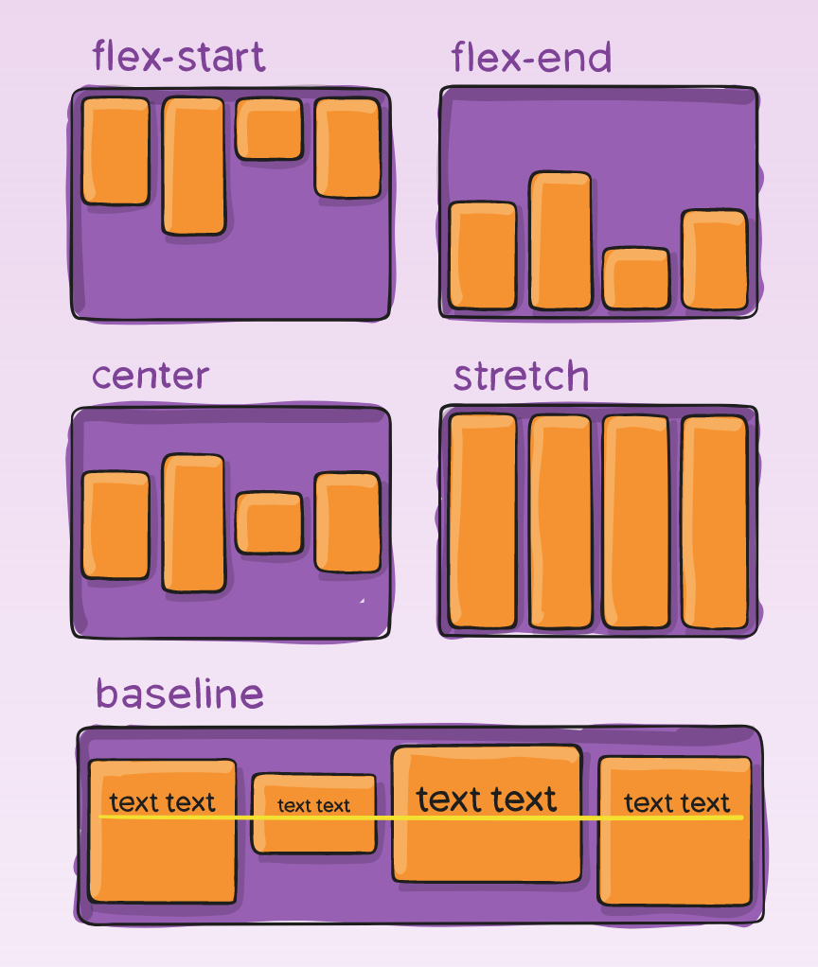
FLEX BOX – align-items
align-items: stretch | flex-start | flex-end | center | baseline;
This defines the default behaviour for how flex items are laid out along the cross axis on the current line.

Slide 21
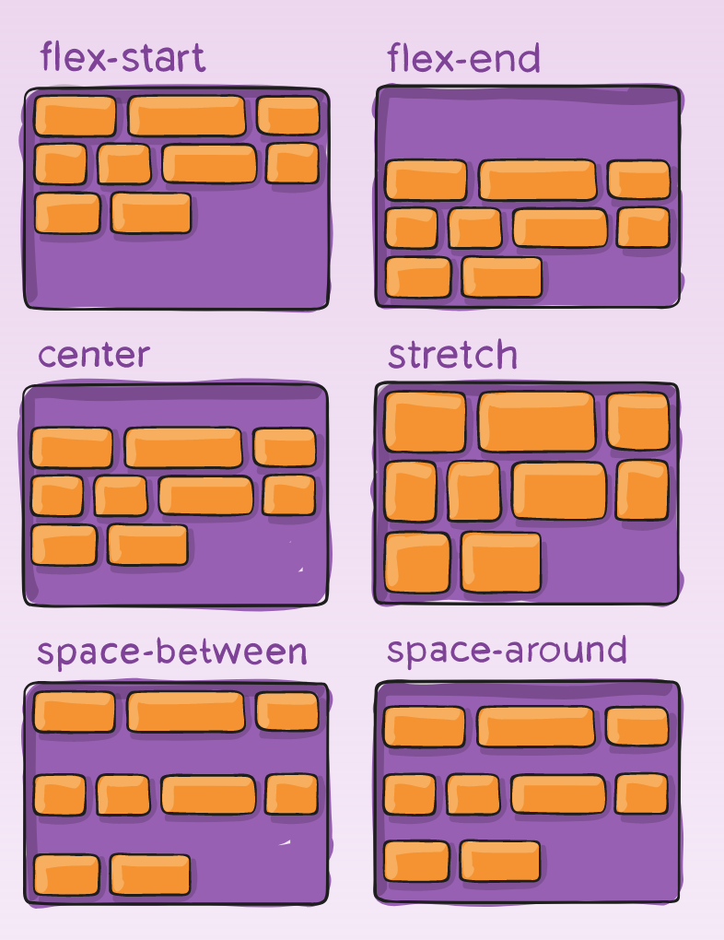
FLEX BOX – align-content
align-content: flex-start | flex-end | center | space-between | space-around | stretch;
This aligns a flex container's lines within when there is extra space in the cross-axis.

Slide 22
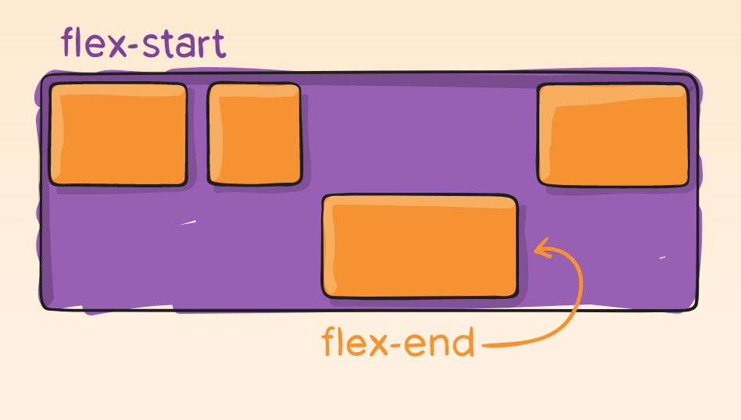
FLEX BOX – align-self
align-self: auto | flex-start | flex-end | center | baseline | stretch;
This allows the default alignment (or the one specified by align-items) to be overridden for individual flex items.
https://css-tricks.com/snippets/css/a-guide-to-flexbox/

Slide 23
GRID LAYOUT
CSS Grid Layout (aka "Grid"), is a two-dimensional grid-based layout system that aims to do nothing less than completely change the way we design grid-based user interfaces.

Slide 24
GRID grid
display
Defines the element as a grid container and establishes a new grid formatting context for its contents.
Values:
grid - generates a block-level grid
inline-grid - generates an inline-level grid
.container { display: grid | inline-grid; }

Slide 25
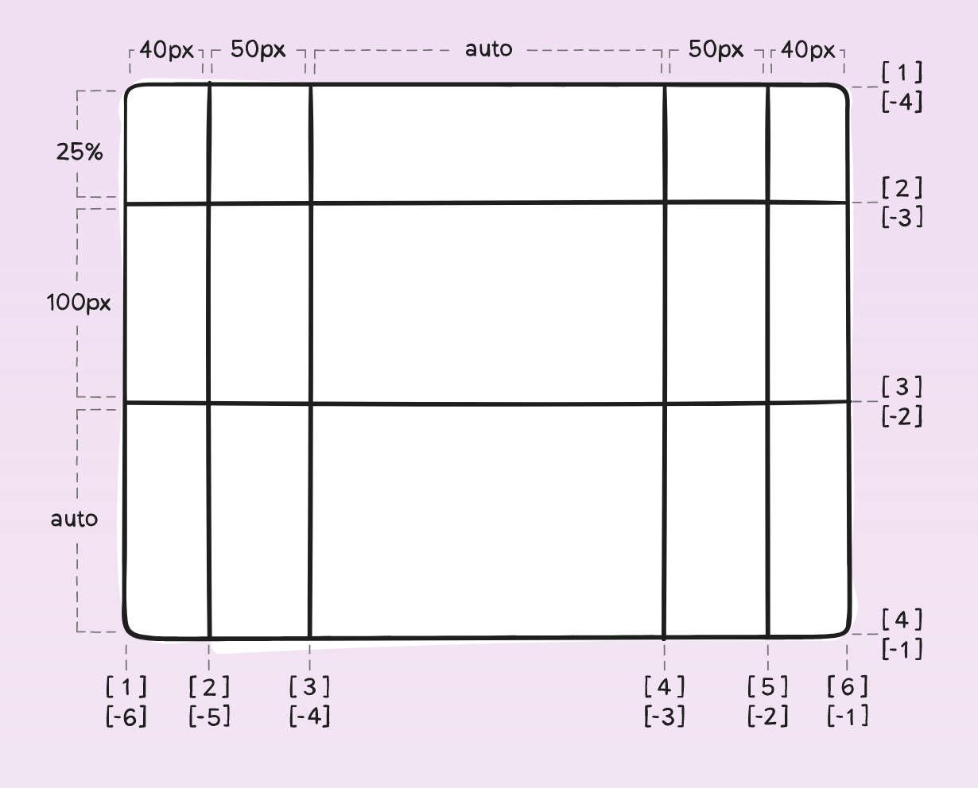
grid-template-columns grid-template-rows
.container {
grid-template-columns: 40px 50px auto 50px 40px;
grid-template-rows: 25% 100px auto;
}

Slide 26
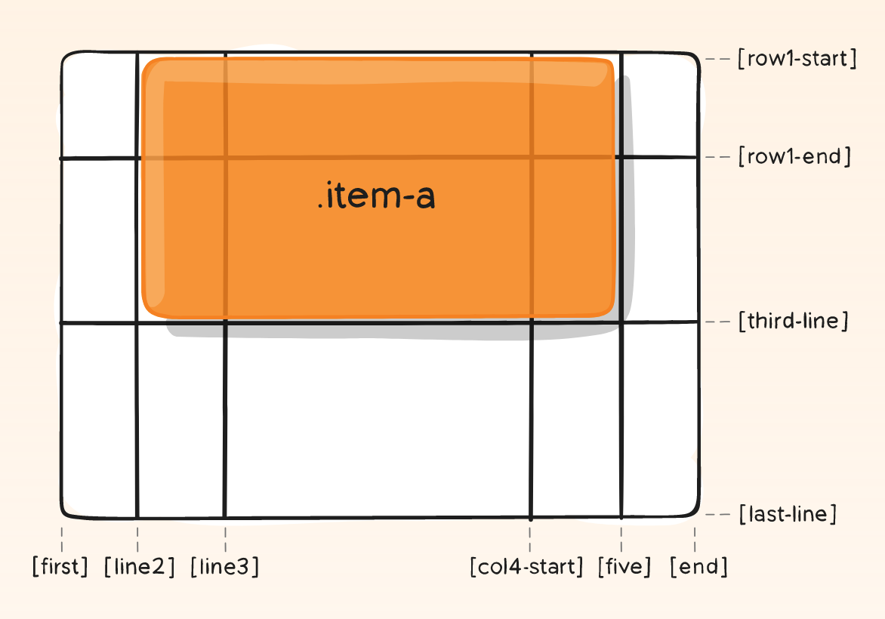
grid-column-start grid-column-end grid-row-start grid-row-end
.item-a {
grid-column-start: 2;
grid-column-end: five;
grid-row-start: row1-start
grid-row-end: 3;
}

Slide 27
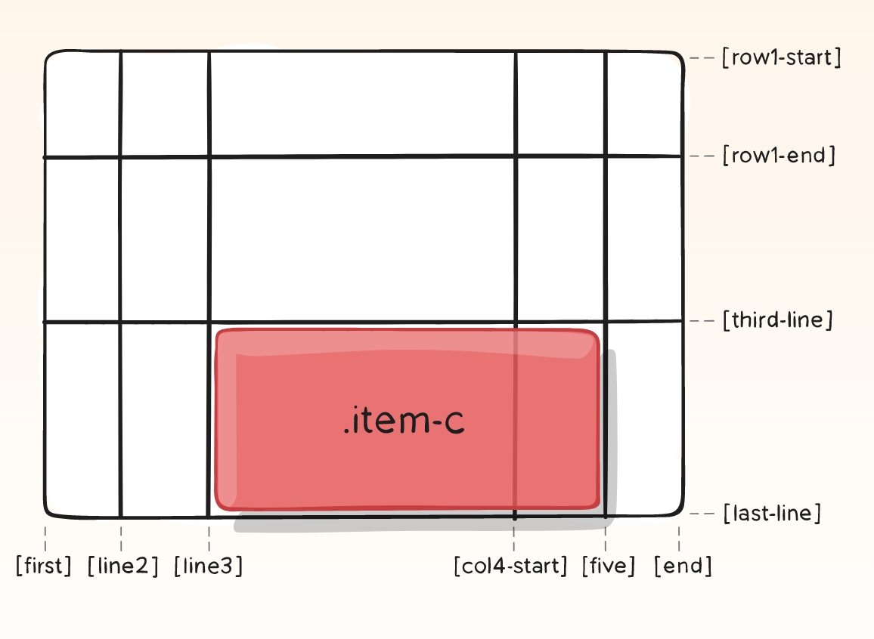
grid-column grid-row
Shorthand for grid-column-start + grid-column-end, and grid-row-start + grid-row-end, respectively.
.item-c { grid-column: 3 / span 2; grid-row: third-line / 4; }

Slide 28
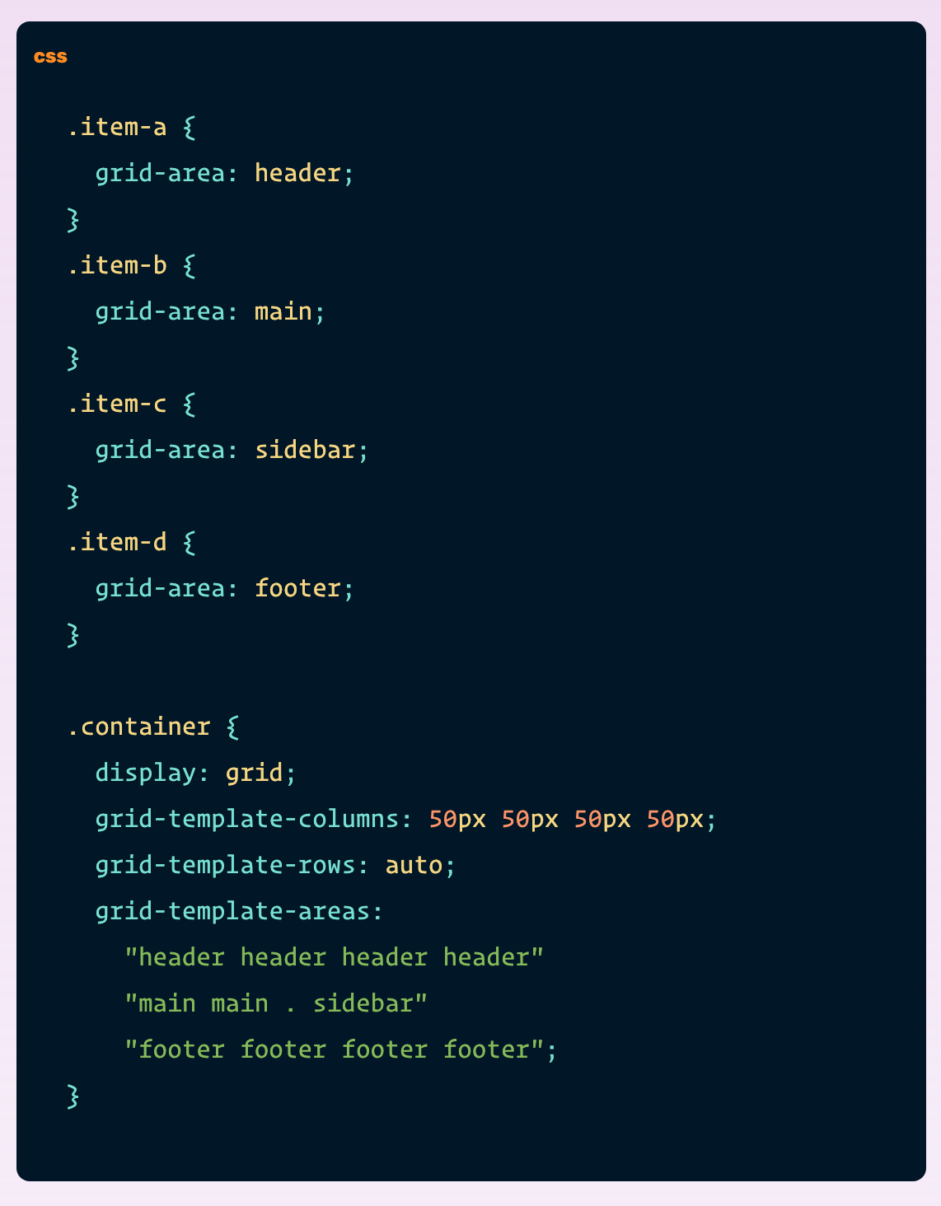
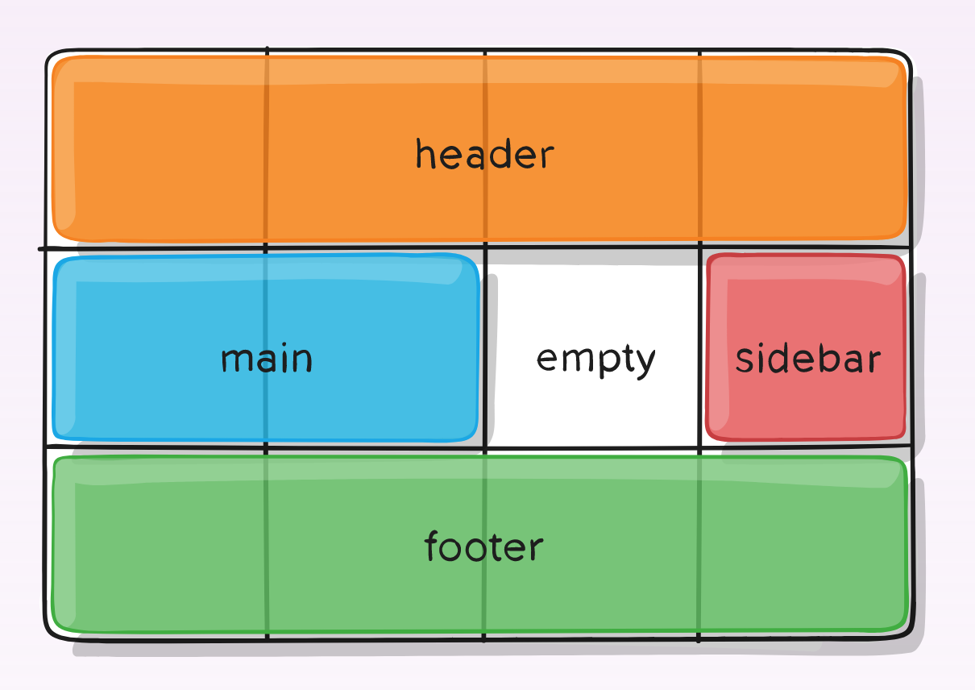
grid-template-areas

